Slide 1

Smart Power Play: Automata-Driven Effficiency in FPGA Embedded Systems
Presented by, K.Rohith Krishna(192210092)
N.Chanakya(192211040)

Slide 2
ABSTRACT
As battery-powered devices become central to modern technology, optimizing energy consumption in embedded systems, especially those utilizing Field-Programmable Gate Arrays (FPGAs), has become increasingly critical. Traditional power management techniques often struggle to adapt to real-time workload variations, leading to inefficient energy usage. This project presents a novel approach to power management through automata-guided control on FPGA platforms, aimed at enhancing energy efficiency while preserving performance in embedded systems.
The proposed solution utilizes finite-state automata (FSA) to dynamically manage power states, including active, idle, and sleep modes, based on real-time monitoring of system workload. Implementing this automata model on an FPGA allows for fast, responsive transitions between power states, leveraging FPGA’s reconfigurable nature to optimize energy usage according to fluctuating operational demands.

Slide 3

Introduction to Smart Power Play
In recent years, the demand for mobile and embedded devices has surged, driven by advancements in fields such as Internet of Things (IoT), mobile computing, and robotics. These battery-powered devices are required to perform increasingly complex tasks while remaining energy efficient, as their utility often hinges on prolonged battery life and low power consumption. Managing power efficiently in these systems has become critical, particularly as energy constraints can limit functionality, responsiveness, and device lifetime. To address these challenges, innovative power management techniques that can adapt to dynamic workload demands are essential, ensuring that power consumption is optimized without compromising system performance. Field-Programmable Gate Arrays (FPGAs) are particularly suited to power-efficient applications, as they offer the flexibility to reconfigure hardware to meet specific performance and power requirements. Unlike Application-Specific Integrated Circuits (ASICs), which are fixed in design, FPGAs can be programmed to dynamically adjust to workload variations, making them ideal for applications where power demands fluctuate.

Slide 4

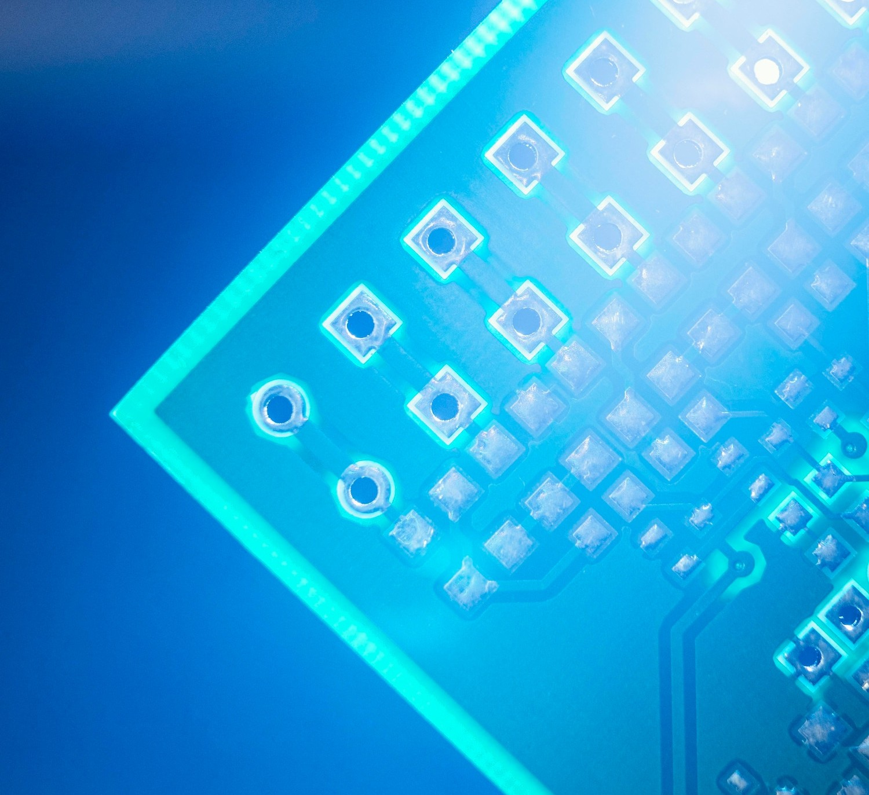
Understanding FPGA Technology
Field Programmable Gate Arrays (FPGAs) are highly versatile and customizable. They enable designers to implement complex algorithms and optimize performance for speciﬁc applications. Exploring their architecture reveals how they can adapt to various tasks efﬁciently.

Slide 5


The Role of Automata in Effficiency
Automata theory provides a framework for designing systems that can automatically adapt to changing conditions. By integrating automata into FPGA designs, we can achieve dynamic resource allocation and signiﬁcantly improve operational efﬁciency.

Slide 6
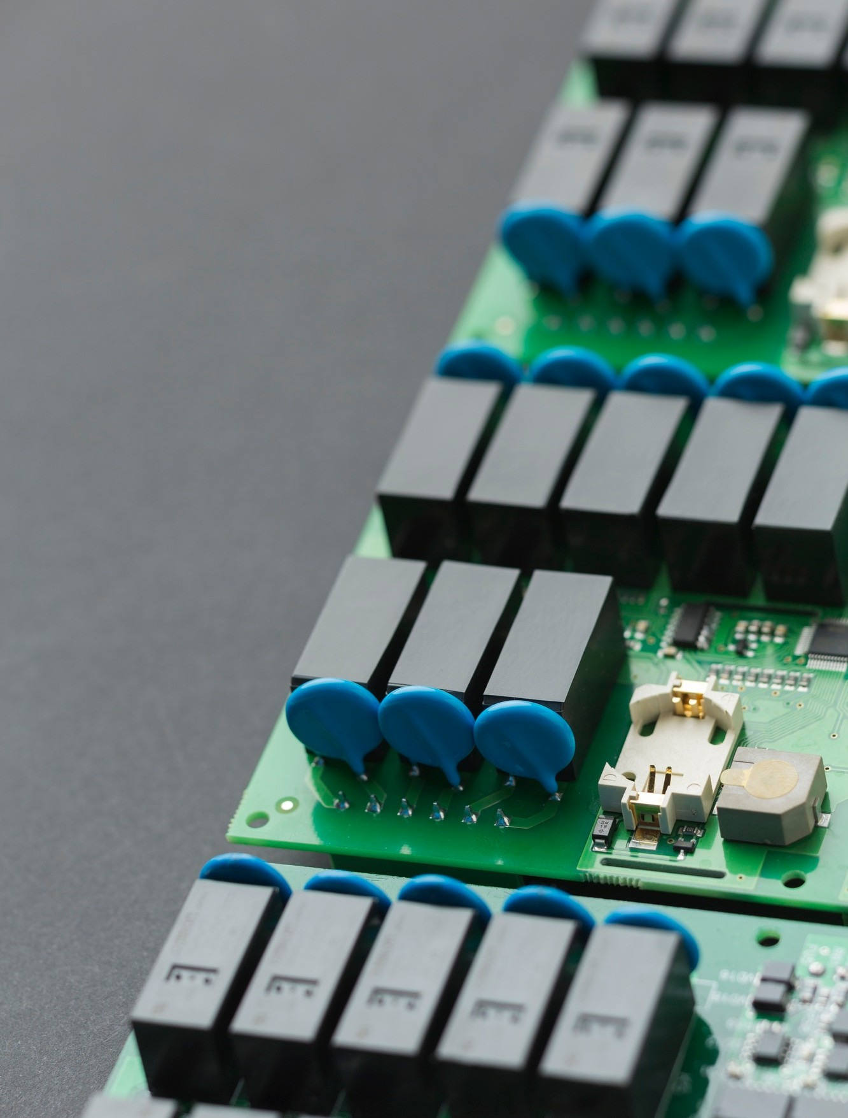
Power Management Techniques
Effective power management is crucial in embedded systems. Techniques such as dynamic voltage scaling and adaptive clocking can be implemented in FPGAs to ensure optimal performance while minimizing energy consumption. These methods pave the way for smarter systems.

Slide 7


Real-World Applications
The integration of automata-driven efﬁciency in FPGAs has vast applications, from automotive systems to telecommunications. These technologies enhance performance, reliability, and energy efﬁciency, making them indispensable in modern electronics.

Slide 8
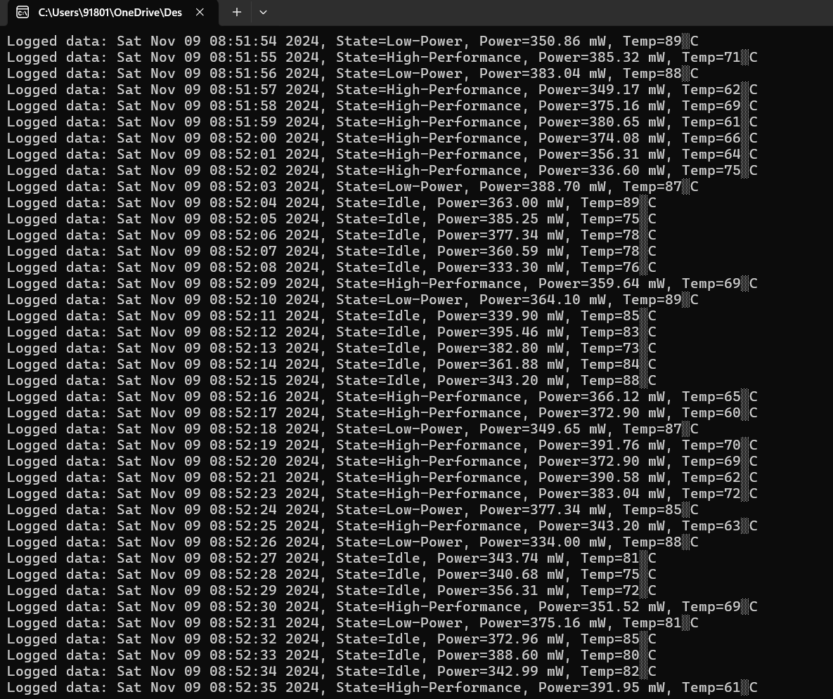
Output
Conclusion:
This project successfully demonstrates the potential of automata-guided power management in FPGA-based embedded systems. By implementing a responsive FSM on FPGA, the system adapts to real-time conditions, providing significant power savings while maintaining performance. The flexibility and reconfigurability of FPGA technology make it ideal for deploying this approach across mobile, IoT, and other battery-dependent applications, offering an effective solution to enhance device sustainability and energy efficiency.

